Slide 1
What is the best browser to use ? Edge, Google Chrome, Mozilla Firefox, or Safari
Done by: Sanada Thomas

Slide 2
AGENDA
Which is the best web browser to use?
Why is it the best?
For each browser three (3) scenarios will be given that it is best used in.

Slide 3
Which is the best web browser to use?

Slide 4
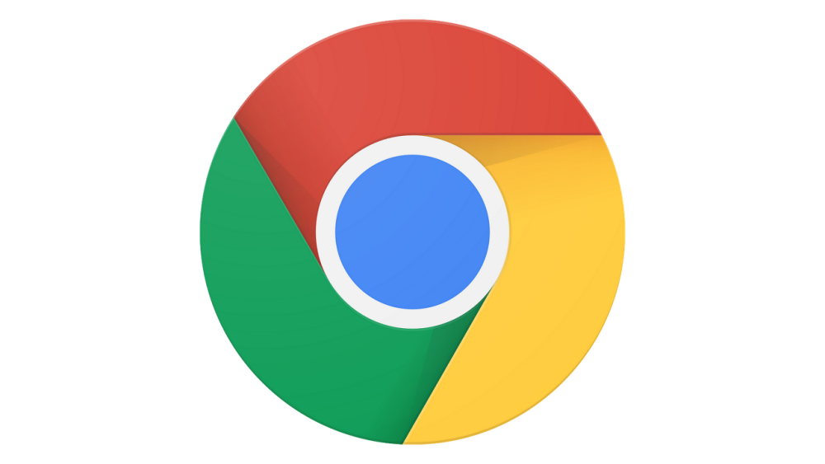
Google Chrome:
0
Because of its notoriously high resource requirements, Chrome can run incredibly slowly on older hardware and RAM (albeit more on Windows than Chrome OS, queue conspiracy theories).Although Chrome continues to be quite resource-hungry, the new Tab Freezing feature is intended to address this by automatically "freezing" background tabs to prevent them from using resources unnecessarily. By no means is Chrome a subpar browser. Contrary to popular belief, it is a fantastic browser with a fantastic add-on library, cross-platform support and sync, excellent autofill features, and some excellent tools for web developers. It has secure DNS lookup for compatible providers (Google's own Public DNS is one of them), can alert you if your email has been compromised, and blocks a ton of hazardous mixed content, including scripts.
l
0
0
0

Slide 5
Google Chrome:
0
The WebXR API for AR and VR is also enabled. Don't overlook Chrome's dark mode either, which makes browsing more comfortable at night.These are all excellent options, but we believe Firefox offers better privacy protection, Edge is more pleasant to use, and other specialized browsers do not instill the lingering worry that Google is slightly meddling in all of our lives.
l
0
0
0

Slide 6
Google chrome
Pros
Cons
Supports a huge extensions library
Syncs across devices
Collects lots of data
Uses lots of memory

Slide 7
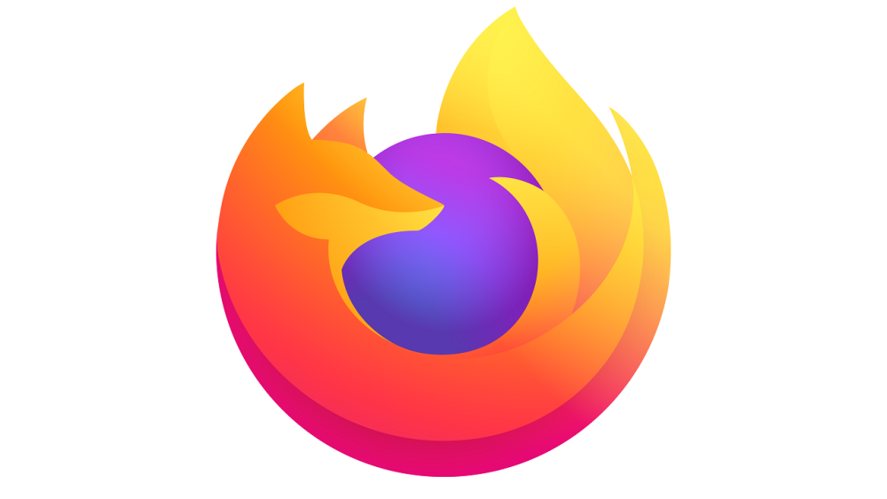
Mozilla Firefox:
0
Firefox is an incredibly diverse web browser with a wide range of applications that include more than web browsing, but its versatility sadly remains unexplored in internet circles. The general flexibility of this browser combined with its user-friendly GUI makes a perfect option for those internet users who wish to go beyond the limits of casual
computer usage.
l
0
0
0

Slide 8
Mozilla Firefox:
0
One particular group of people who might find these features useful are hardcore gamers, who due to their particular means of computer usage need to be extra cautious on how the allocate RAM and pressure the graphics cards of their machines. On its own, Firefox is normally very RAM heavy and filled with things such as reporting data back to its home company due to its status as an all-purpose browser. However, experienced browser and computer users can modify the settings and preferences and use browser add-ons to cut down on the amount of RAM saved and even extend the life of the computers in question, which allows for a more streamlined and lightweight browsing experience.
l
0
0
0

Slide 9
Mozilla Firefox:
0
This versatility is also a great boon for cybersecurity personnel, who might be running multiple applications or even a single application that uses up a lot of RAM and puts pressure on the graphics card and need a way to quickly browse the internet while saving on space.
Best for security
Prevents tracking
Blocks cryptominers
l
0
0
0

Slide 10
Mozilla Firefox
Pros
Cons
Protects against spyware
Blocks almost all pop-ups
Consumes high memory
Falls behind other browsers in speed

Slide 11
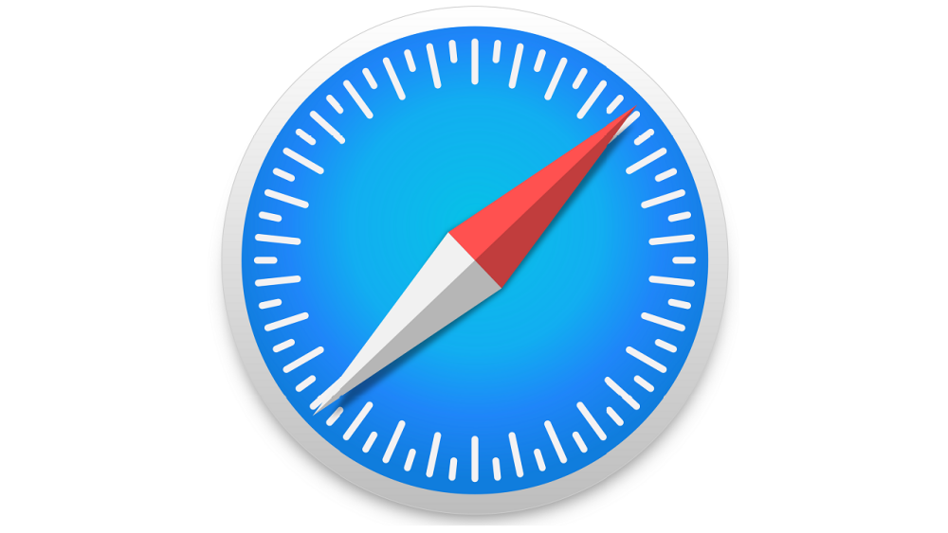
Apple safari:
l
l
l
The most obvious advantage of using Safari on a Mac is that it’s already there when you set up a new Mac, so you can use Safari immediately, without needing to download anything. As Apple’s default browser, Safari has its advantages, such as built-in functionality to store your bookmarks and browsing history in iCloud, along with your usernames and passwords in iCloud Keychain, making it easy to log in and synchronize your browsing across all your Apple devices associated with your iCloud account. Apple recently raised the issue of fingerprinting protection, which stops web trackers from identifying you based on your system specifications. Unfortunately, Safari only exhibits partial protection from trackers in the EFF's Cover Your Tracks test site, whereas several competitors show Strong protection. Support for Apple Pay and a "Sign in with Apple" feature that takes the place of Facebook and Google as web account authorizers are two additional advantages.
l

Slide 12
Apple safari
l
l
l
If you use an iPhone and a Mac, Safari integration makes a lot of sense, since Apple’s Handoff feature lets you continue your browsing session between devices. Safari also trails other browsers on support for emerging HTML features
l

Slide 13
Apple safari
Pros
Cons
Runs superfast on Macs
Uses low memory
Isn’t available outside Apple’s ecosystem
Has a limited extensions library

Slide 14
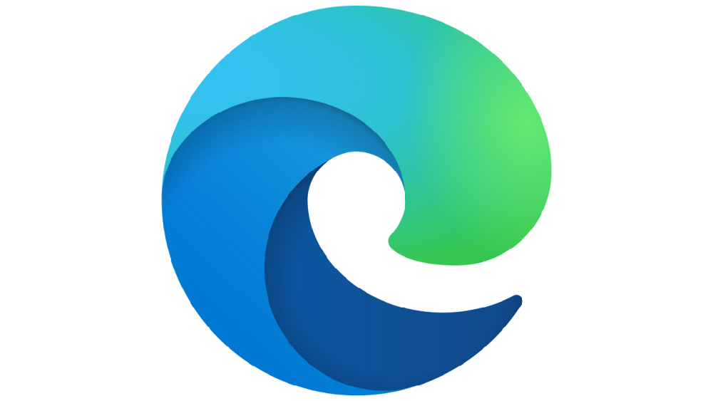
Microsoft edge
l
l
l
Because Microsoft Edge is based on the Chromium open source project, which is the foundation of Google Chrome, it shares the same carefully engineered and rigorously tested security architecture and design. The story of Microsoft Edge's security doesn't end there. In fact, Microsoft Edge is safer for your Windows business than Google Chrome. It has strong, native support for hardware isolation on Windows and strong built-in defenses against malware and phishing—no additional software is needed to achieve this secure baseline. Furthermore, Microsoft Edge adds extra, strong security capabilities and features that help protect against data loss when combined with native support for Microsoft 365 security and compliance services, providing even more advantages.
l

Slide 15
Microsoft edge
l
l
l
Other noteworthy Edge features include integrated web sharing, tabs that run along the side rather than across the top, a built-in screenshot tool, automatic coupons for online stores, and regular browser themes. A multitasking sidebar that lets you access first- and third-party services for social networking, search, messaging, search, and productivity are recent additions. Another is game controller haptic feedback for web gaming.
l

Slide 16
Microsoft edge
pros
cons
Synchronizes across devices
Includes a PDF viewer
Lacks a version for Linux
Collects your browser history

Slide 17
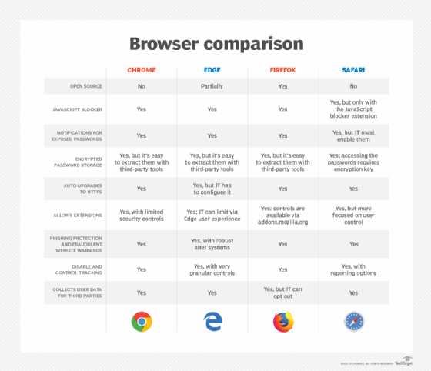
Microsoft edge
pros
cons
Synchronizes across devices
Includes a PDF viewer
Lacks a version for Linux
Collects your browser history

Slide 18
Conclusion
The choice of web browser can be very personal, but it is frequently influenced by current workflows and the rest of the IT stack. As with any software deployment, the final decision(s) should be made only after testing internal assets that the browser can access from different locations, external resources that are used frequently (to ensure that they render and function properly), and security and data privacy.

